Slide 1



SOIL TO SOUL
AI-BASED NUTRITION EARLY WARNING SYSTEM
Team Members
(PG – MCA):
Pratham Chavda (17)
Riddhi Chheda (18)
Ramesh Chourasiya (19)
Vedant Deshmukh (20)
Sohan Devadiga (21)
Gaurav Dixit (22)
Guided By:
Dr. Ashwini Renvikar
Institute:
Thakur Institute of Management Studies, Career Development & Research (TIMSCDR)
Mumbai University

Slide 2

Introduction to SOIL TO SOUL
Understanding the Importance of Nutrition and Soil Health
Connects soil health, crop nutrition, and human well-being.
Uses AI to predict and identify nutrition-risk zones early.
Helps communities take proactive action to prevent nutrition issues.
Promotes sustainable agriculture and better health outcomes.

Slide 3
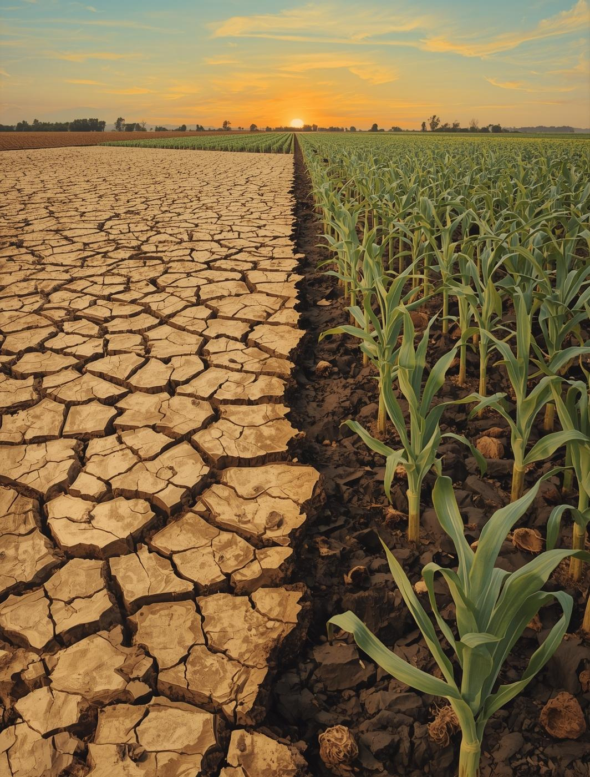
Problem Statement
Addressing the urgent challenge of nutrition-related health issues
Soil nutrient degradation lowers crop nutritional value.
Poor crop nutrition contributes to malnutrition and related health problems.
Lack of an integrated soil–crop–nutrition system delays early detection.
Delayed interventions lead to long-term community impacts and higher healthcare costs.

Slide 4

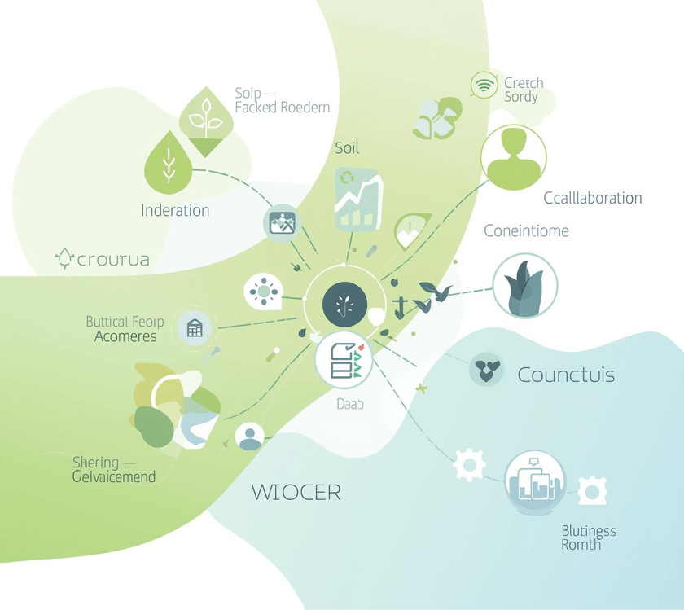
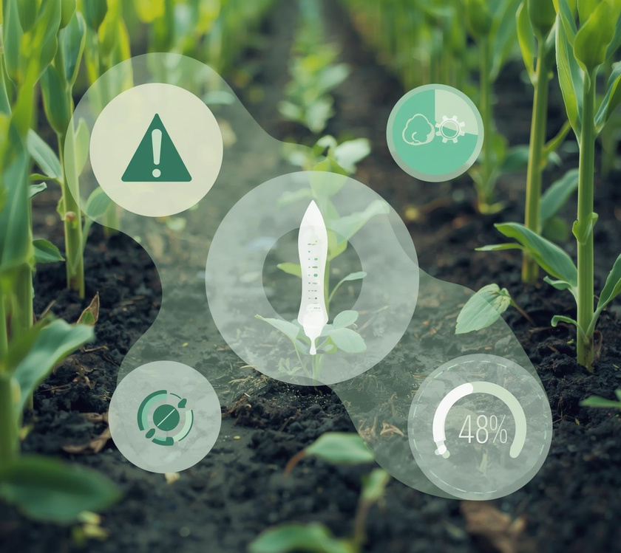
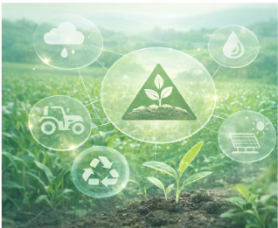
Objectives
AI System
Integrated Data
Early Warning
Sustainable Agriculture
To develop a system predicting nutrition risks
Combining soil, crop, and health data together
Building a machine learning early warning system
Encouraging environmentally friendly farming

Slide 5
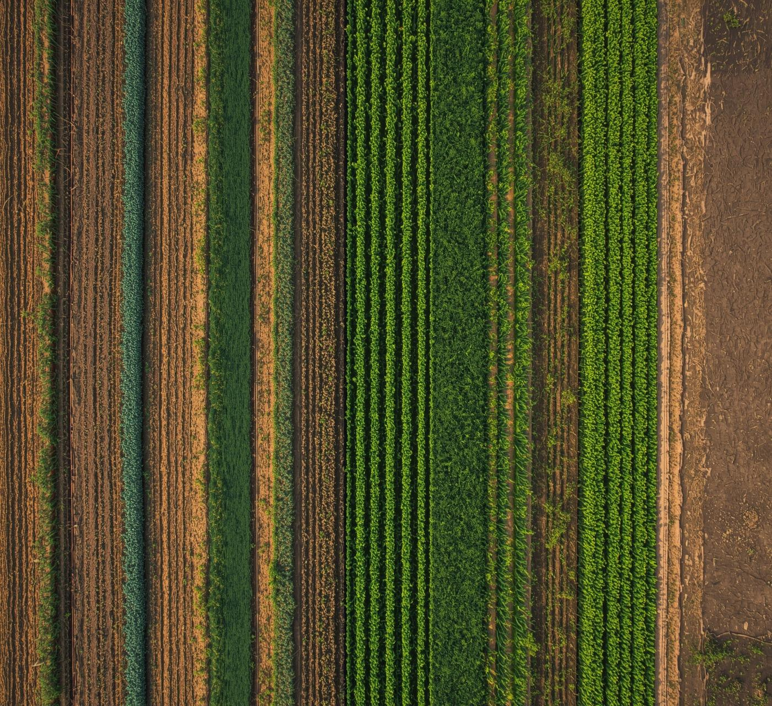

Literature Review
FAO Research
FAO reports that soil nutrient depletion reduces crop nutrient density and lowers food micronutrient levels.
FAO’s Soils4Nutrition initiative highlights that healthy soil is crucial for producing nutrient-rich crops, especially in developing countries.
UNICEF Findings
WHO Reports
UNICEF reports show that child malnutrition is strongly linked to household food quality, which depends on soil fertility.
Poor soil → low-nutrient crops → poor diet → higher child anemia and stunting.
WHO reports show rising global nutrition deficiencies caused by poor-quality diets and micronutrient-poor crops.
WHO links hidden hunger (micronutrient deficiency) to declining soil quality in agricultural regions.
IPNI / Soil Science Studies (International Plant Nutrition Institute)
Studies show that soil nutrients like Nitrogen (N), Phosphorus (P), and Potassium (K) significantly influence crop protein, vitamin, and mineral content.
Micronutrient deficiencies (e.g., Zinc, Iron) in soil reduce the micronutrient levels in grains and vegetables.

Slide 6
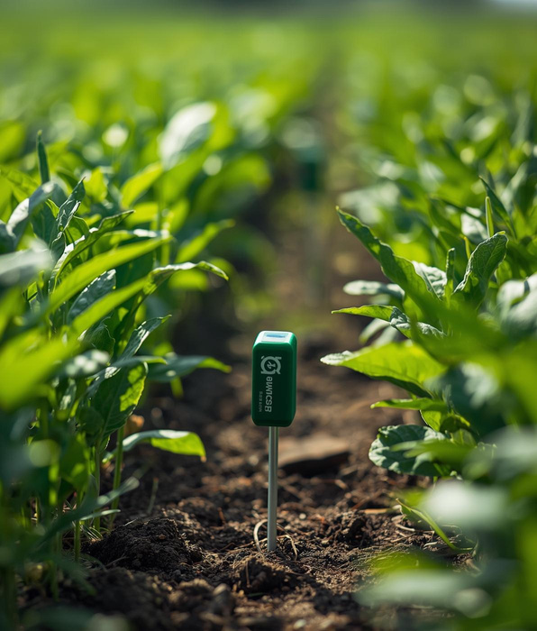
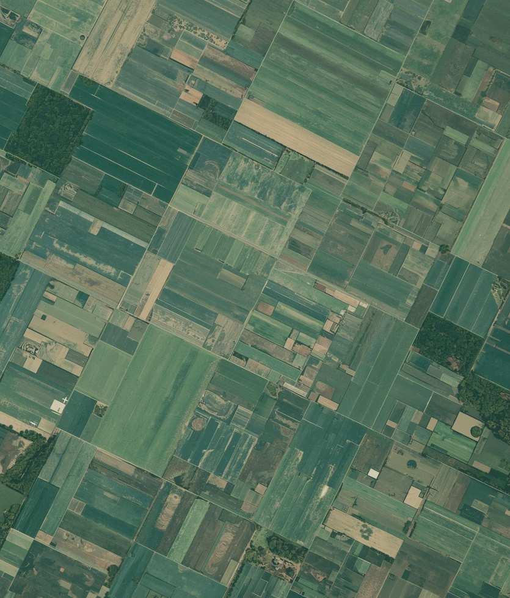

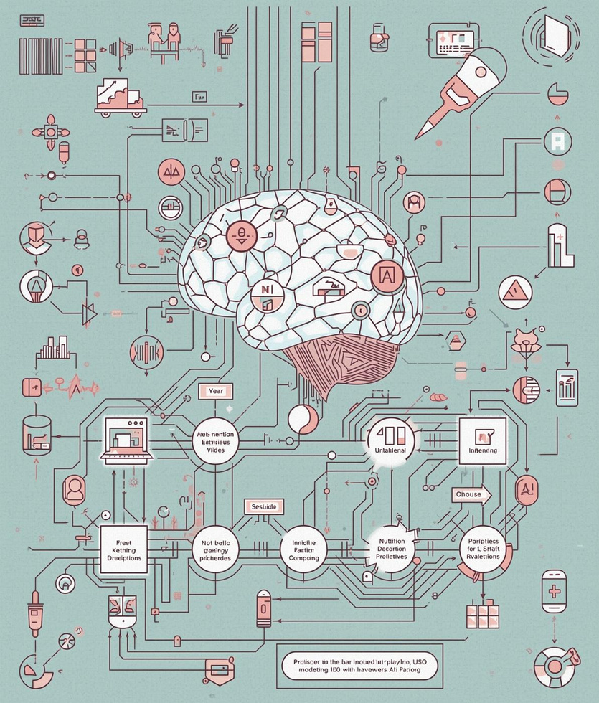
Proposed Methodology Overview
Collect Soil Data
Gather Crop Data
Include Health Indicators
Apply ML Models
Gather nutrient levels from IoT sensors
Use satellite imagery for crop analysis
Assess community health from local records
Develop predictive models for nutrition risks

Slide 7
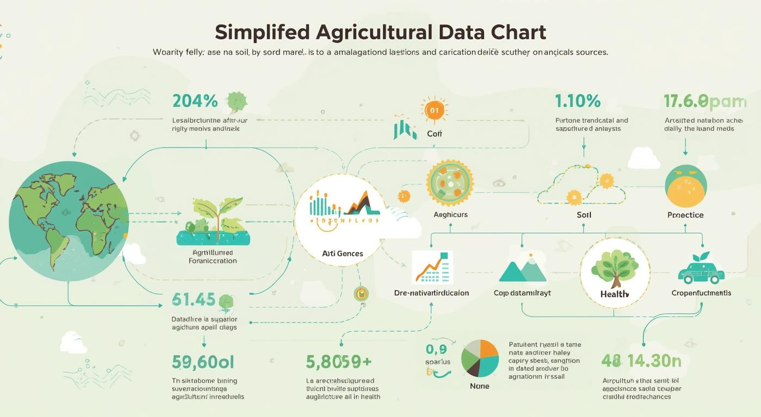
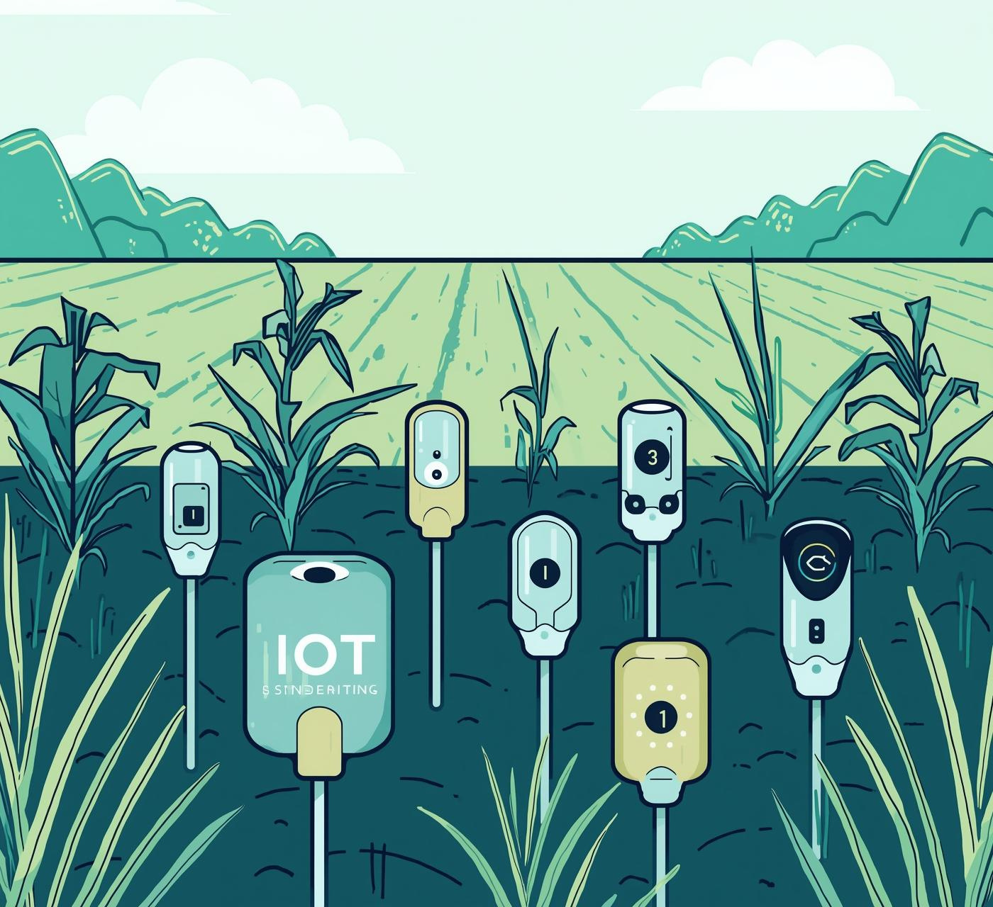
Data and Tools
Data Sources
IoT sensors collect real-time soil nutrient data.
Additional Data Source
Satellite Imagery provides crop growth, vegetation index (NDVI), and land health insights.
Technologies
Machine learning algorithms analyze complex data patterns.
Cloud Platform
Cloud Storage & Processing (Firebase/AWS/GCP) stores all soil, crop, and health data securely for analysis.

Slide 8



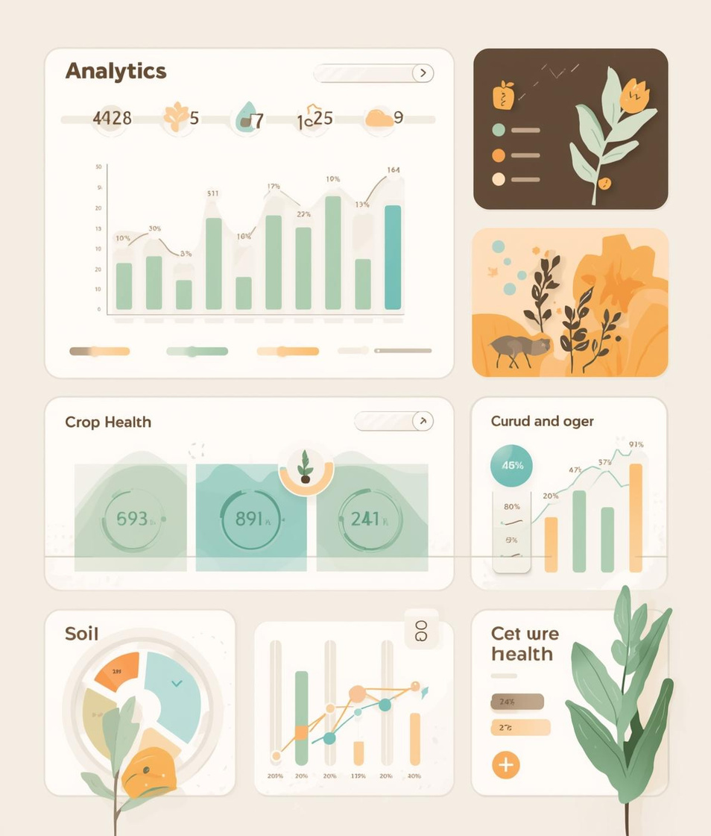
Implementation and Model Design
IoT Layer
Data Processing
AI/ML Model
Analytics Dashboard
Real-time soil nutrient data collection
Integrating and cleaning diverse datasets
Predicting nutrition risk levels accurately
Visualizing soil and crop nutrition data

Slide 9
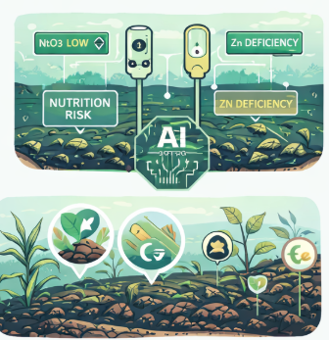

Results & Analysis
Model Performance
ML model accurately detects soil nutrient deficiencies and predicts nutrition-risk zones.
Model accuracy increases when soil, crop, and health data are combined rather than used separately.
Correlation Findings
Low soil micronutrients (Zn, Fe) strongly correlate with reduced crop nutrient density.
Regions with poor soil health have a higher likelihood of community nutrition problems.
Impact of Early Warning System
Provides farmers with timely soil management recommendations (fertilizer balance, crop rotation).
Enhances monitoring of vulnerable regions at risk of malnutrition.
System Advantages
Detects nutrient decline faster than manual field checks.
Combines IoT, satellite, and health data for more accurate predictions.
Provides early alerts to reduce nutrition-related risks.

Slide 10
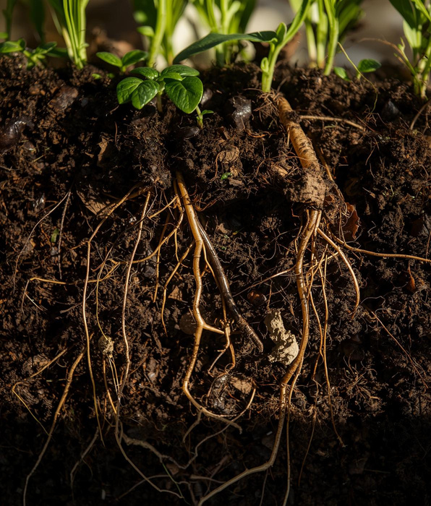
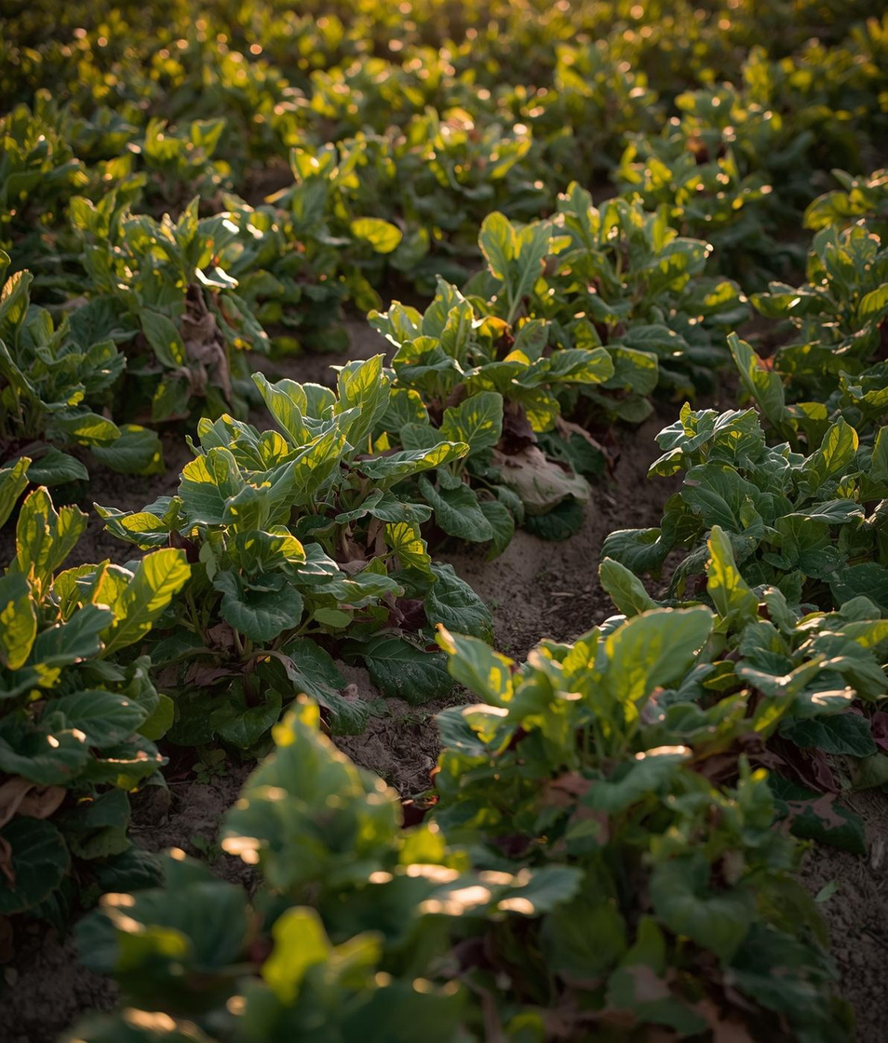


Key Areas of Focus
Soil Degradation
Crop Nutrition
Integrated System
Early Warning
Nutrient loss impacts crop health significantly
Poor nutrition leads to health issues
No links between soil and health data
Delayed interventions worsen health outcomes

Slide 11

Conclusion
Linking soil health, crop nutrition, and human well-being through AI insights
The SOIL TO SOUL system emphasizes the critical connection between soil health and nutrition. By leveraging AI technology, we can enable early detection of nutritional risks, encouraging sustainable agricultural practices and proactive healthcare strategies. This model serves as a scalable solution to enhance food quality and improve community health outcomes.

Slide 12
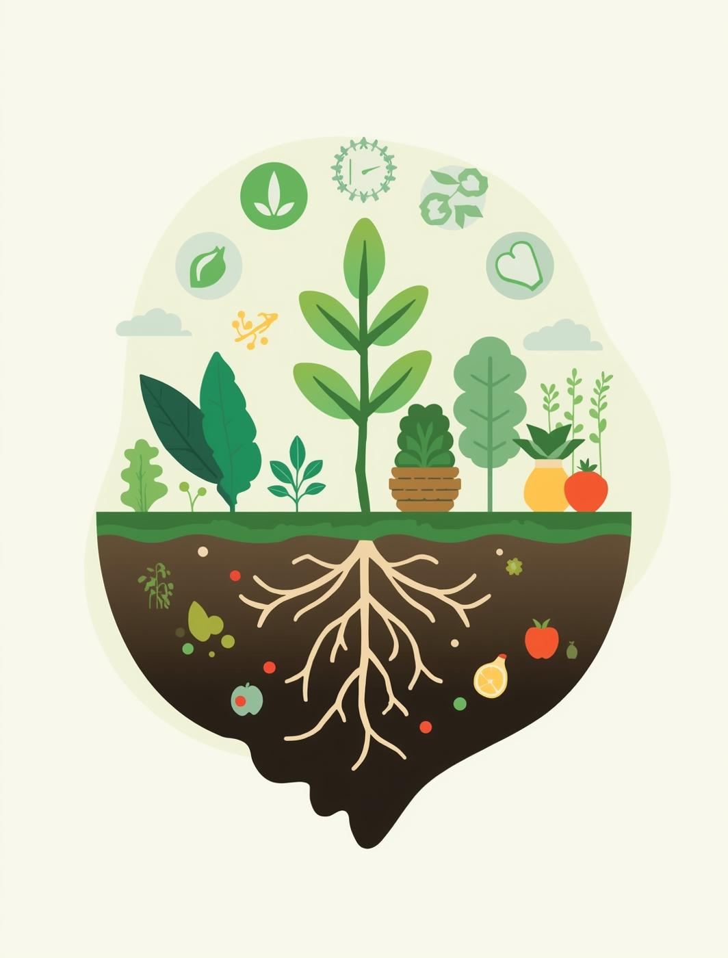
References
[1] FAO – Soils4Nutrition (2025)
Sustainable Soil Management for Nutrition-Sensitive Agriculture
🔗 https://www.fao.org/global-soil-partnership/pillars-action/1-soil-management/soils4nutrition/en/
[2] FAO, IFAD, UNICEF, WFP, WHO – The State of Food Security and Nutrition in the World 2024
Global report on hunger, nutrition, and food systems
🔗 https://openknowledge.fao.org/items/ebe19244-9611-443c-a2a6-25cec697b361
[3] WHO – The State of Food Security and Nutrition in the World 2025
WHO’s global nutrition and food security assessment
🔗 https://www.who.int/publications/m/item/the-state-of-food-security-and-nutrition-in-the-world-2025
[4] FAO – Better Land, Soil & Water Management for Feeding 10 Billion People (2025)
FAO report on sustainability and agricultural resilience
🔗 https://www.fao.org/newsroom/detail/better-land--soil-and-water-management-key-to-feeding-10-billion-people--fao-warns/en/

Slide 13


Thank You for Your Attention
Soil Health Initiative

